Slide 1
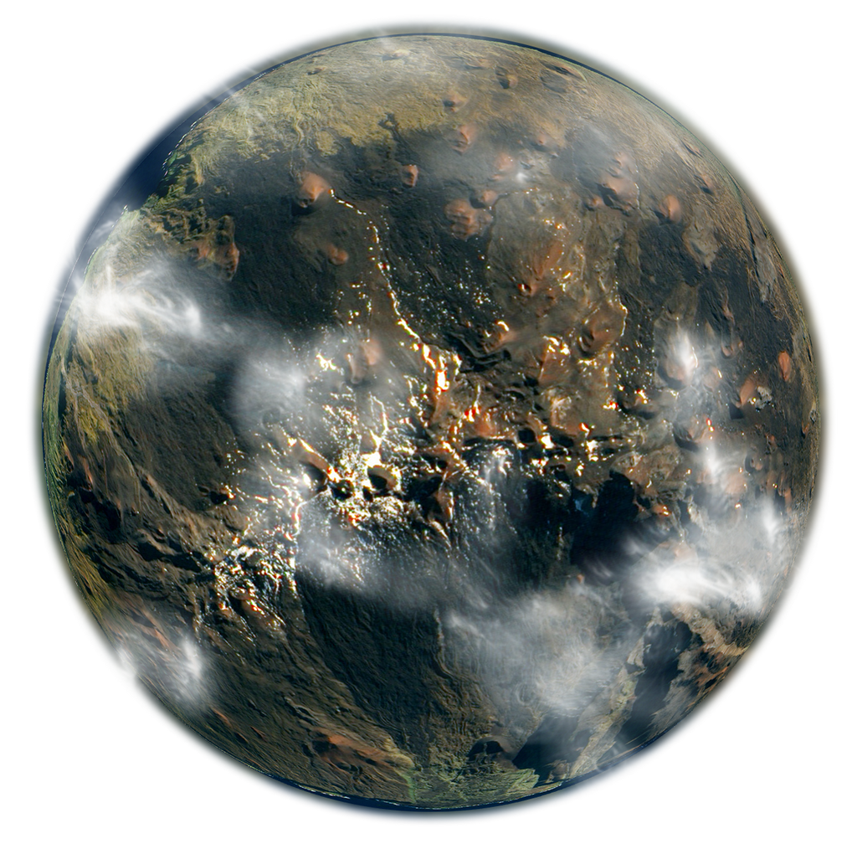
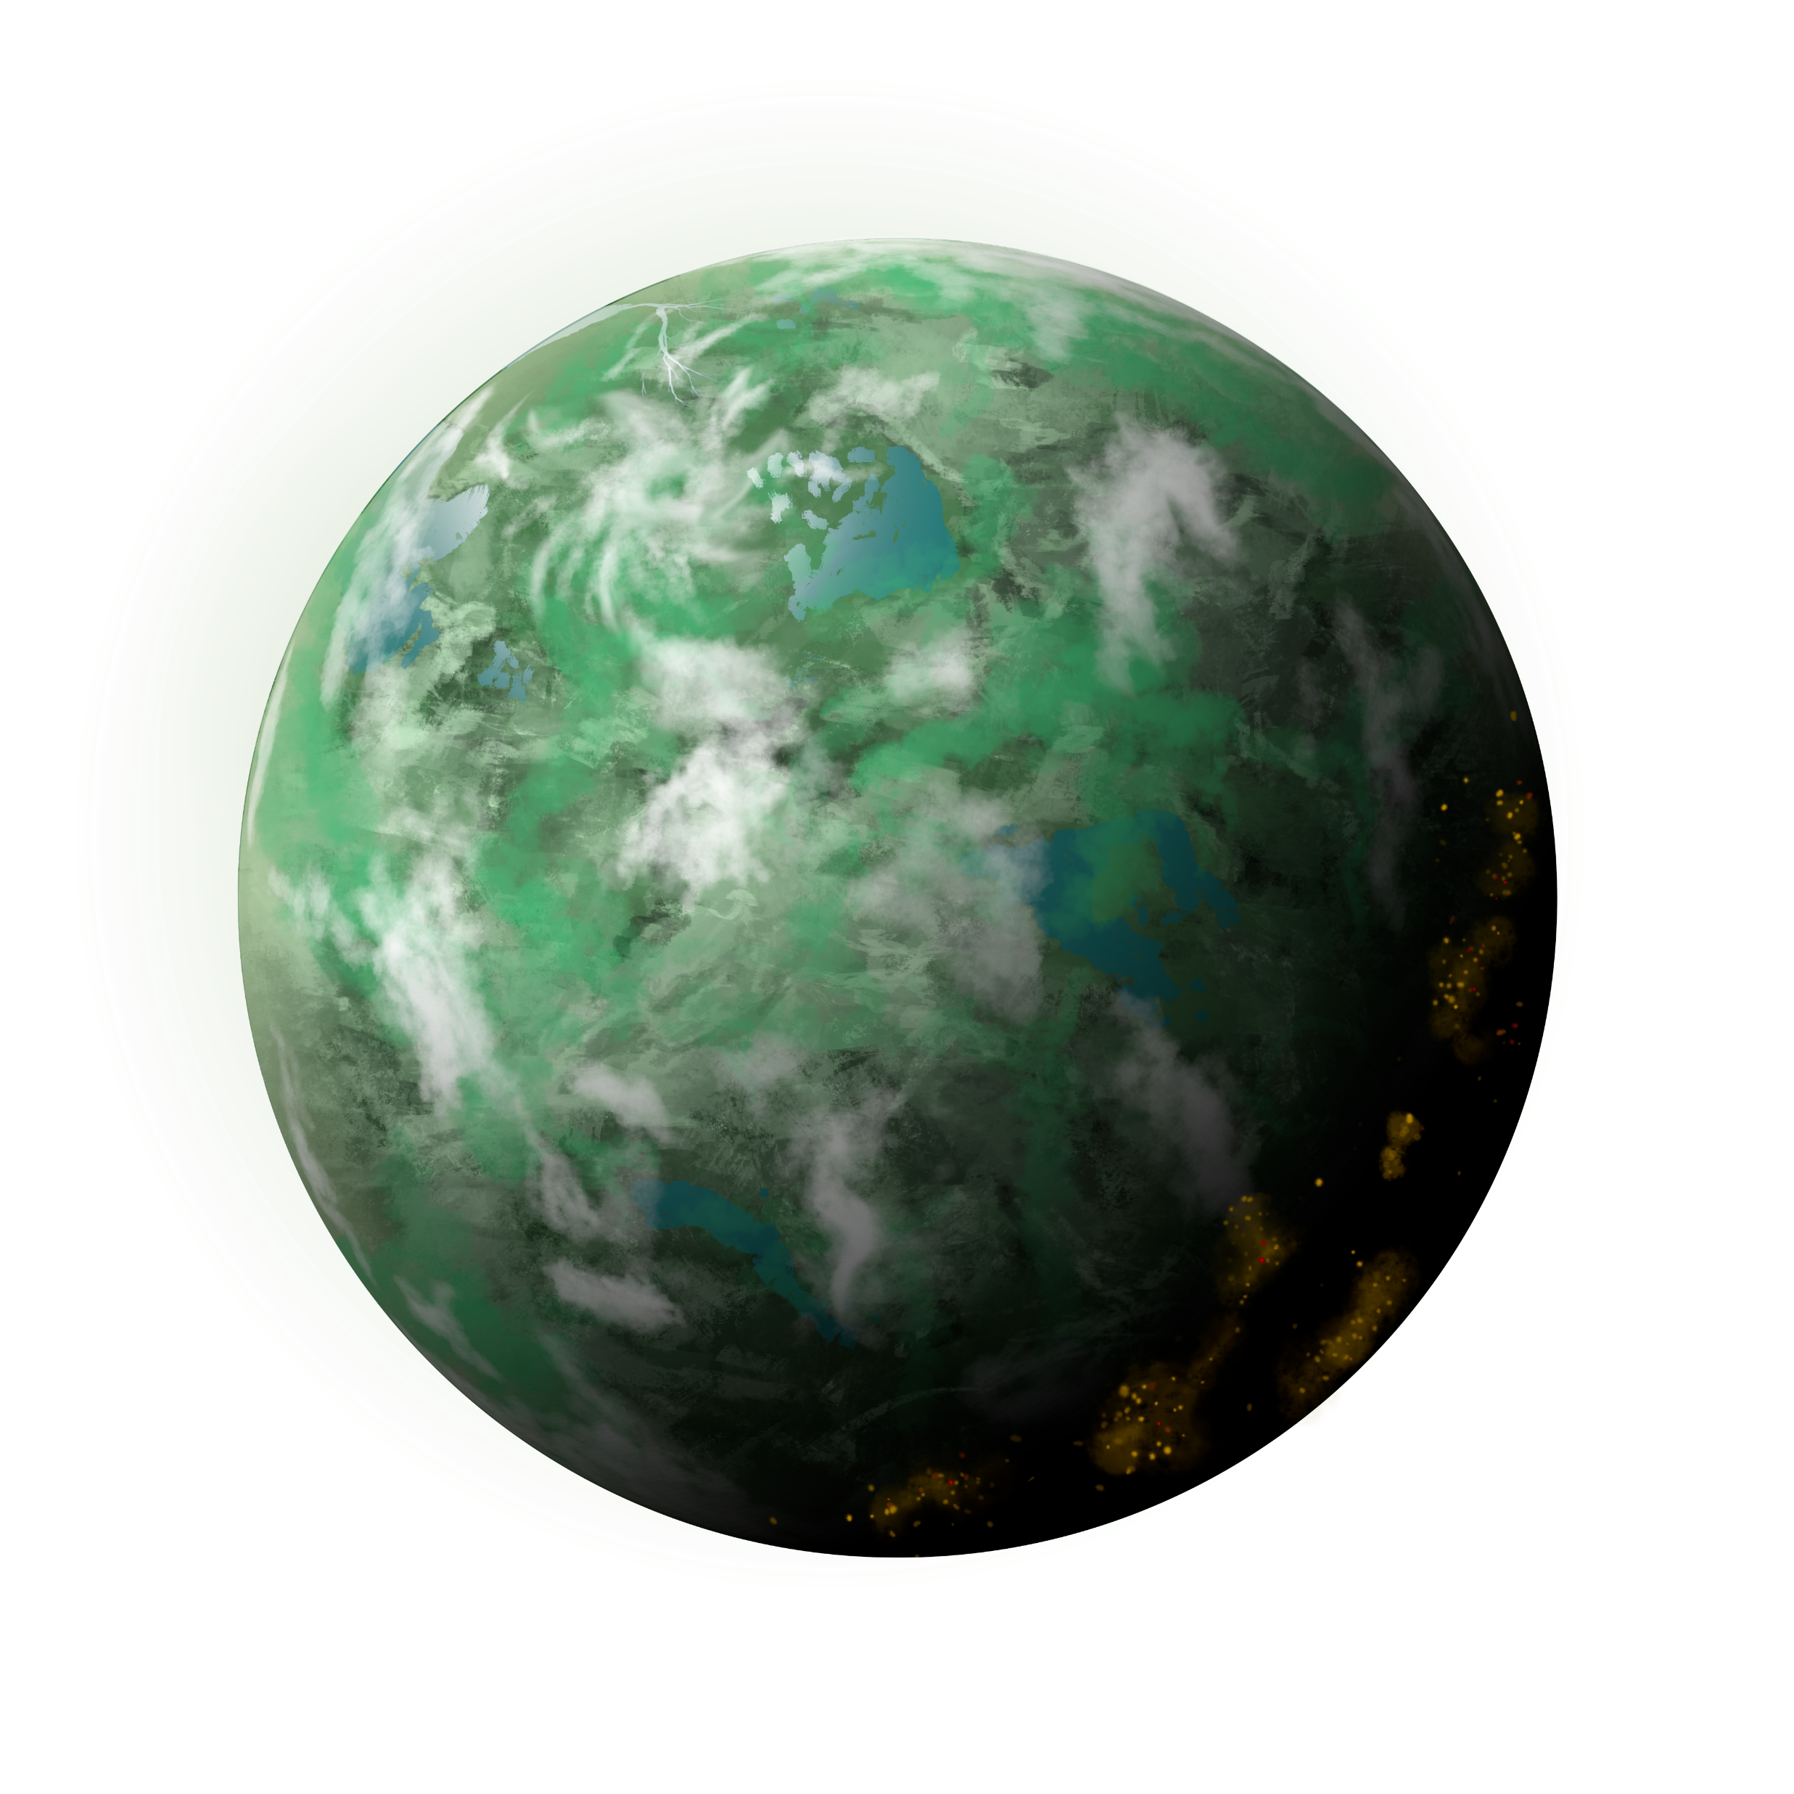
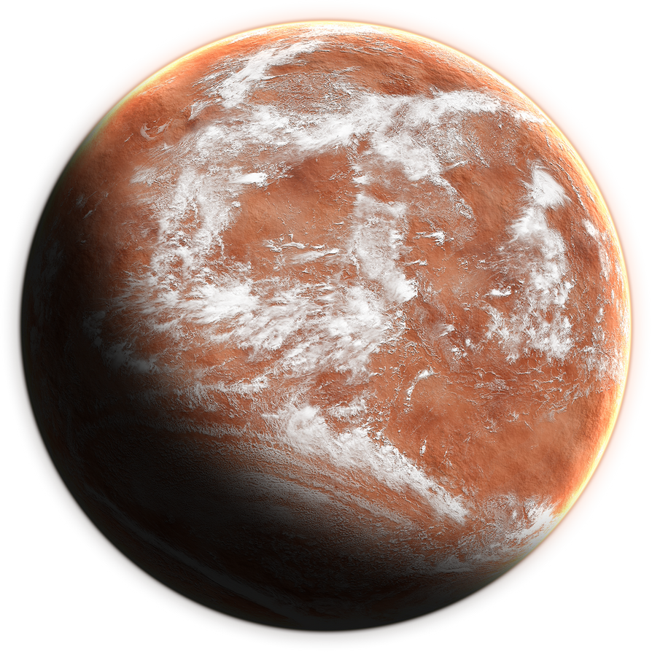
Discovering Exoplanets
Unsupervised Learning Process using Clusters
by Lawrence Quesada

Slide 2
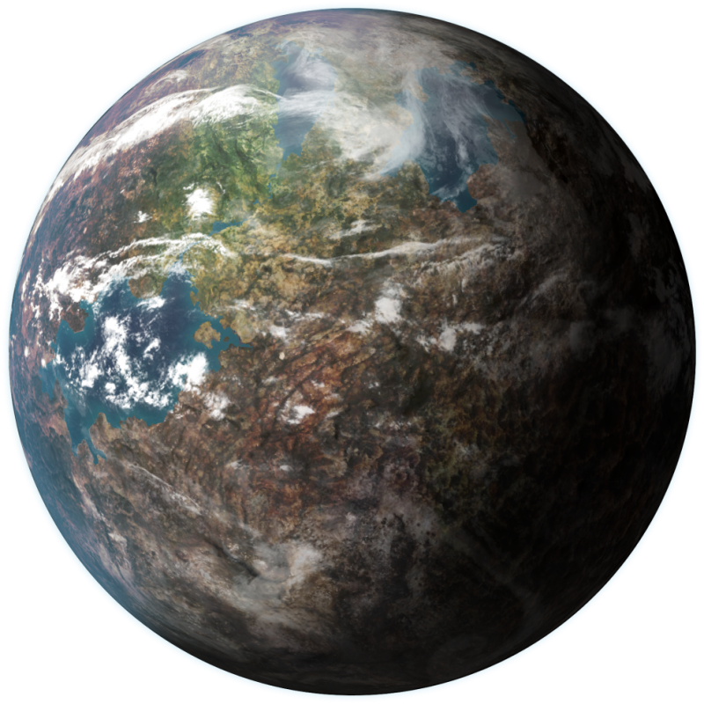
Contents
The Dataset
Exploratory Data Analysis
Preparing the Dataset
Model Selection / Tuning
Conclusion
Target Audience
Future Considerations

Slide 3



The Dataset, Published 2017
https://www.kaggle.com/nasa/kepler-exoplanet-search-results
https://exoplanetarchive.ipac.caltech.edu/cgi-bin/TblView/nph-tblView?app=ExoTbls&config=koi
9, 564 Observations
49 Features

Slide 4
Error Features
'koi_period_err1', 'koi_period_err2', 'koi_time0bk_err1', 'koi_time0bk_err2', 'koi_impact_err1', 'koi_impact_err2', 'koi_duration_err1', 'koi_duration_err2', 'koi_depth_err1', 'koi_depth_err2', 'koi_prad_err1', 'koi_prad_err2', 'koi_insol_err1', 'koi_insol_err2', 'koi_steff_err1', 'koi_steff_err2', 'koi_slogg_err1', 'koi_slogg_err2', 'koi_srad_err1', 'koi_srad_err2'

Slide 5
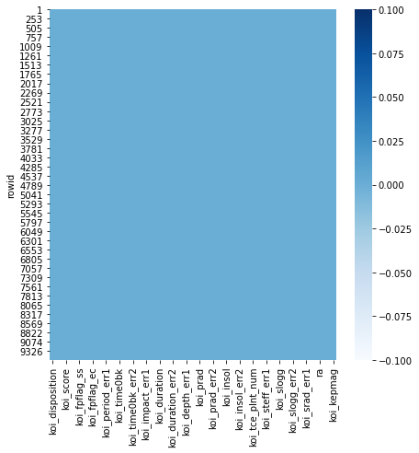
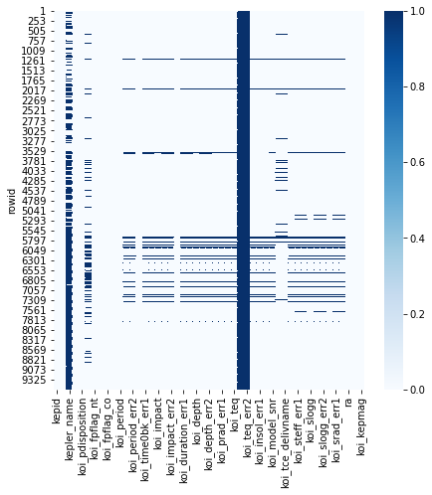
Missing Values

Slide 6
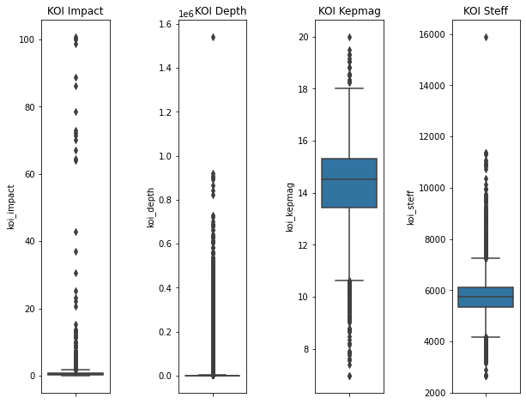
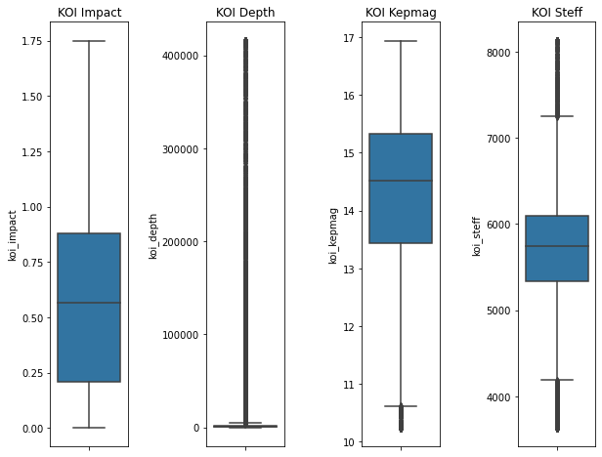
Outliers

Slide 7
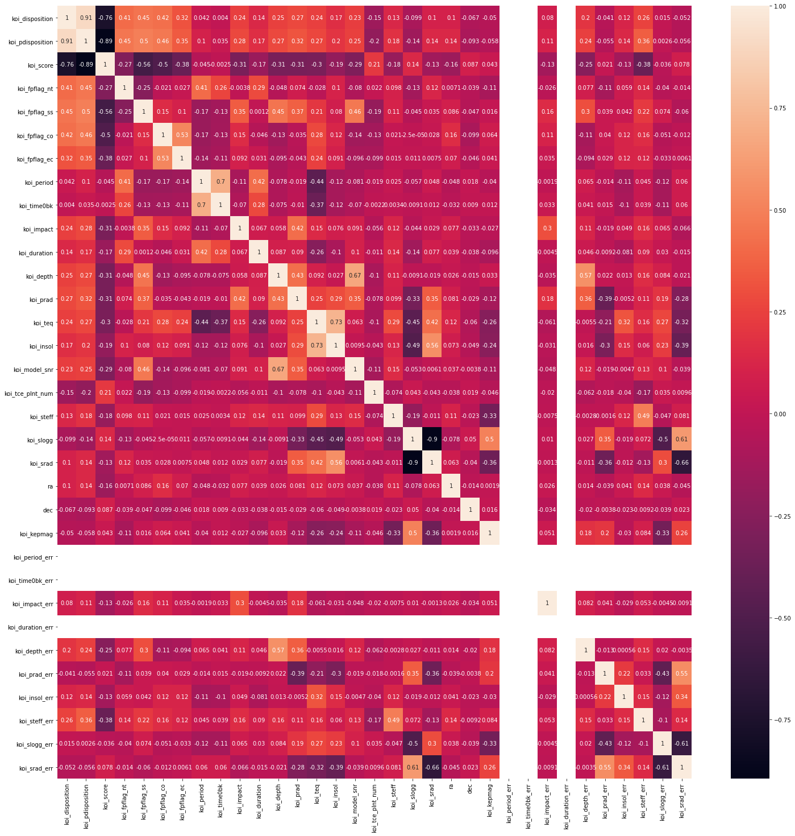
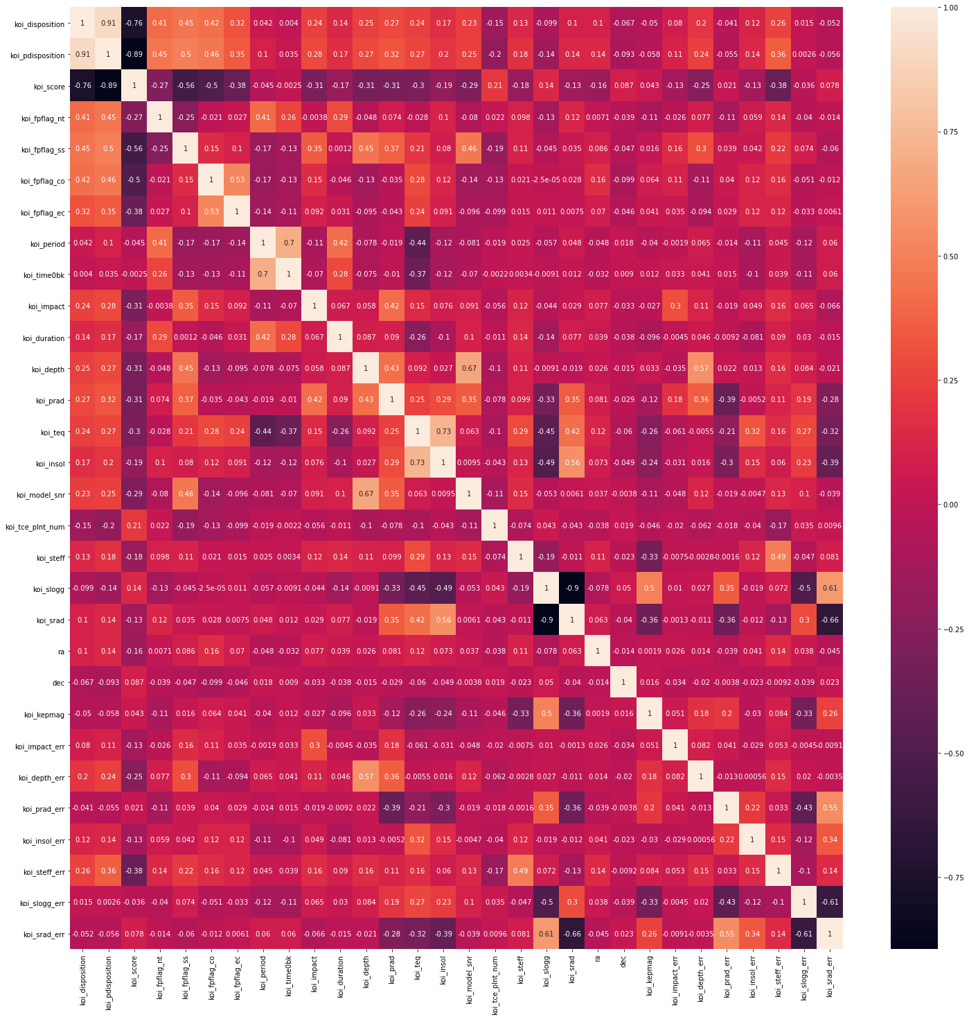
Correlations

Slide 8
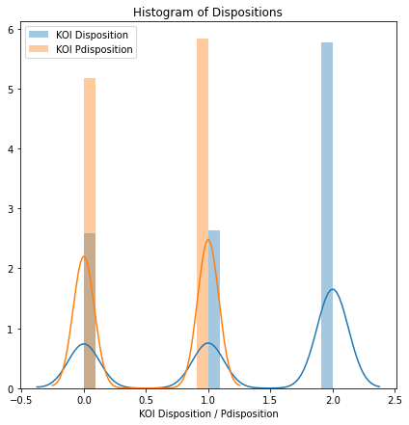
- Confirmed
- False Positive
- Candidate

Slide 9
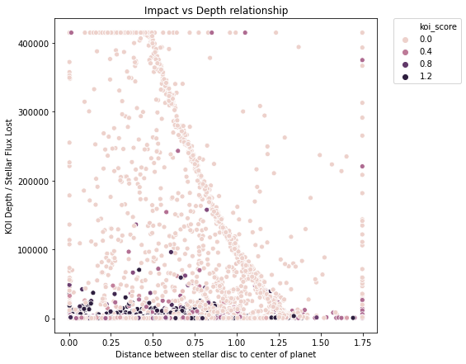
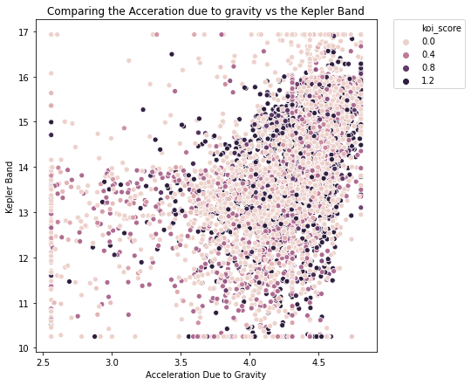

Slide 10
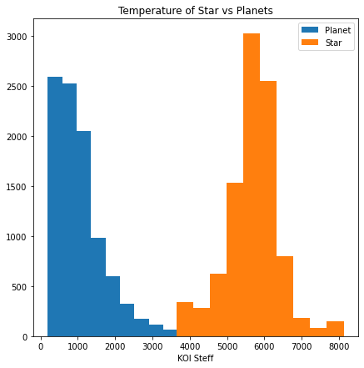
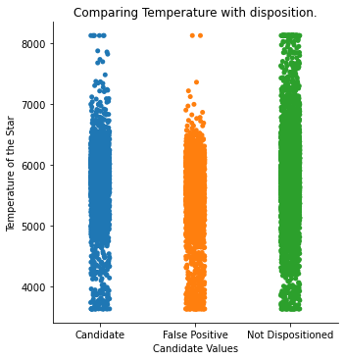

Slide 11
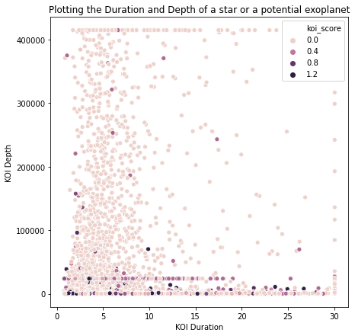

Slide 12
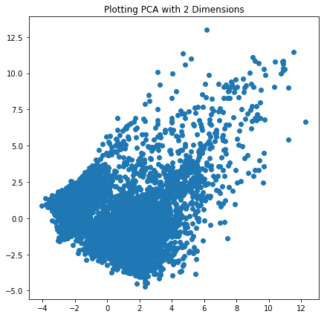


Slide 13
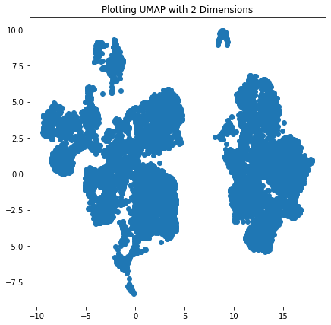
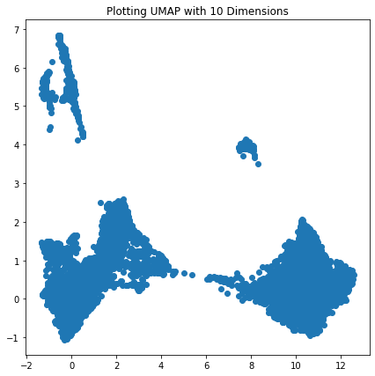

Slide 14
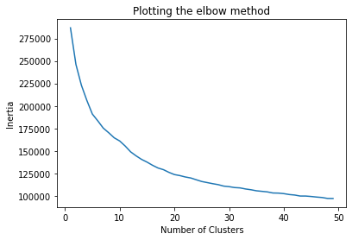
5 Clusters
15 Clusters

Slide 15
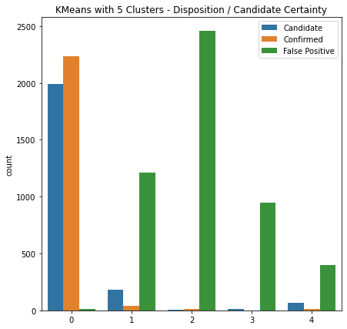
KMeans with 5 Clusters
Standard Scaling
Cluster Number | Number of values clustered
Cluster 0 | 485
Cluster 1 | 963
Cluster 2 | 1422
Cluster 3 | 2457
Cluster 4 | 4236

Slide 16
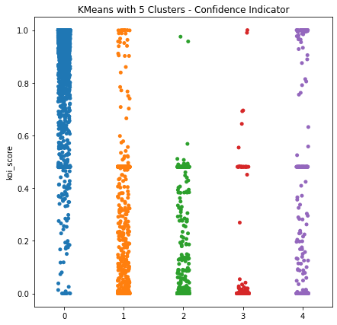
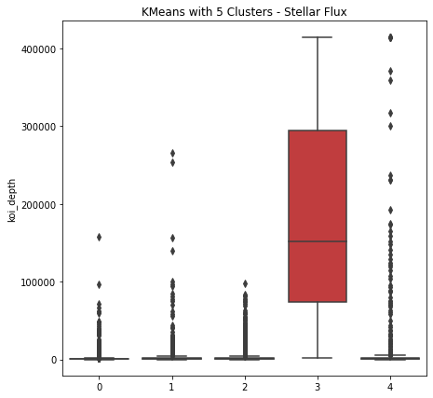
KMeans with 5 Clusters

Slide 17
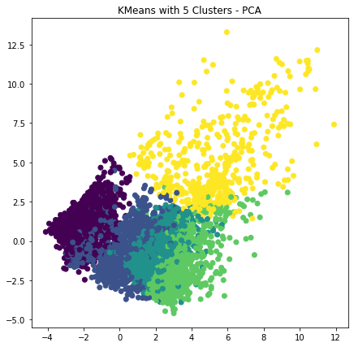
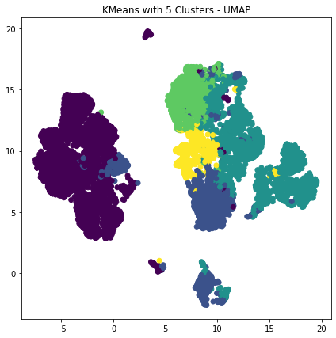
KMeans with 5 Clusters

Slide 18
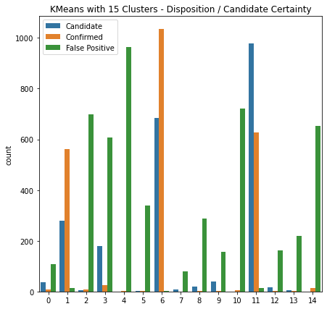
KMeans with 15 Clusters
Cluster Number | Number of values clustered
Cluster 0 | 1083
Cluster 1 | 1441
Cluster 2 | 466
Cluster 3 | 303
Cluster 4 | 821
Cluster 5 | 973
Cluster 6 | 245
Cluster 7 | 142
Cluster 8 | 396
Cluster 9 | 179
Cluster 10 | 199
Cluster 11 | 1313
Cluster 12 | 679
Cluster 13 | 1223
Cluster 14 | 100

Slide 19
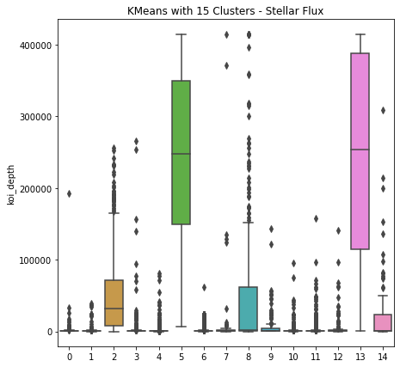
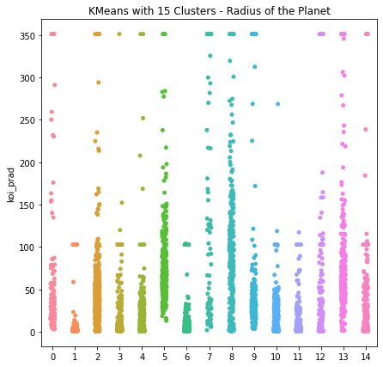
KMeans with 15 Clusters

Slide 20
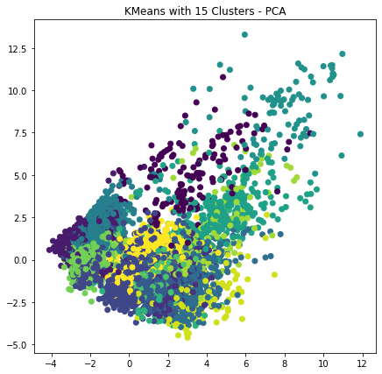
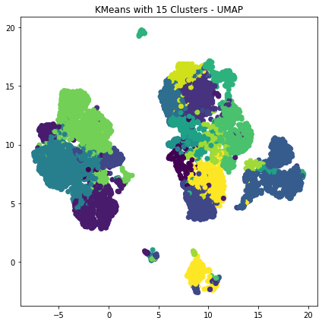
KMeans with 15 Clusters

Slide 21
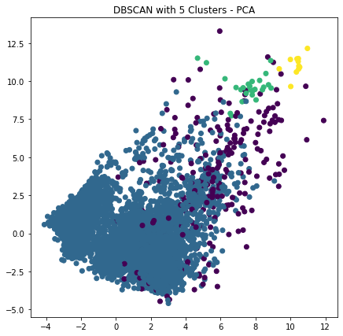
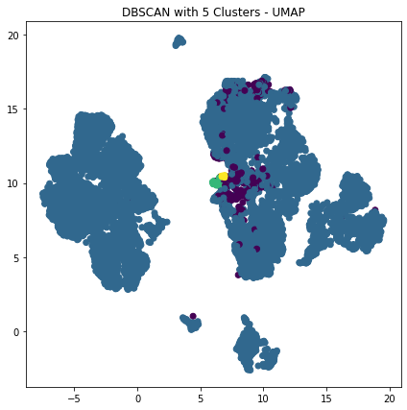
DBSCAN epsilon 5

Slide 22
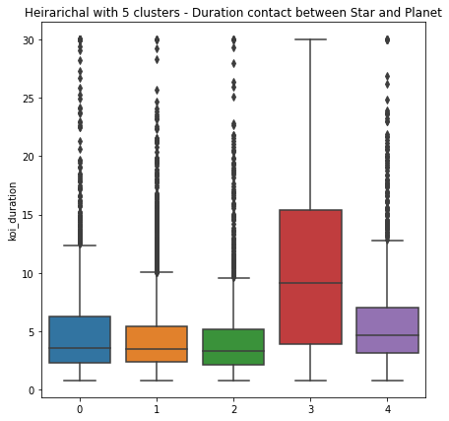
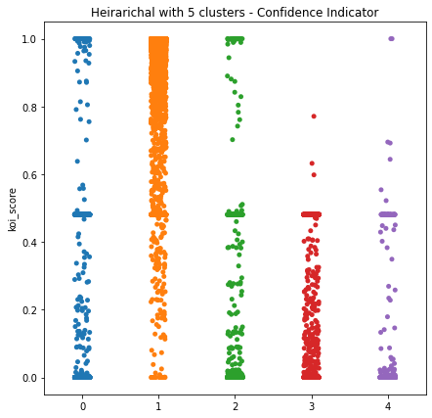
Hierarchal Clustering ‘ward’ method with 5 clusters

Slide 23
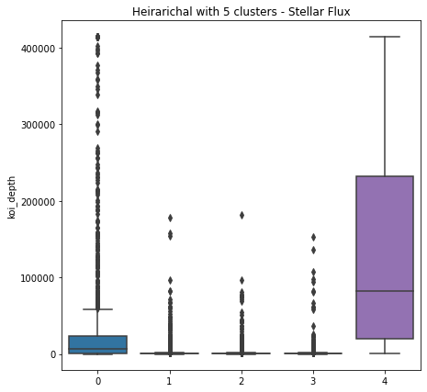
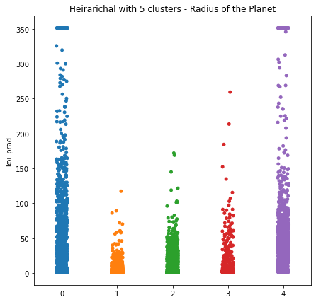
Hierarchal Clustering ‘ward’ method with 5 clusters

Slide 24
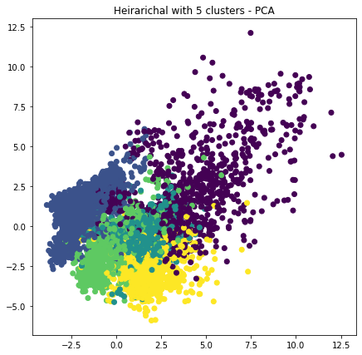
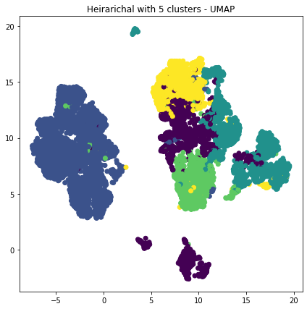
Hierarchal Clustering ‘ward’ method with 5 clusters

Slide 25
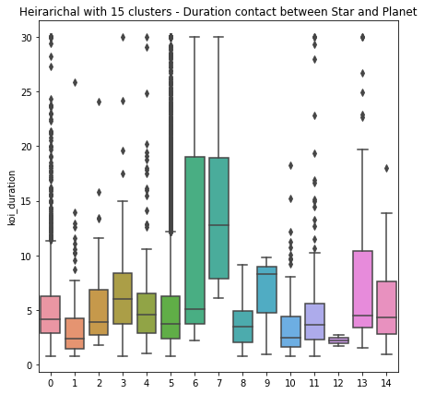
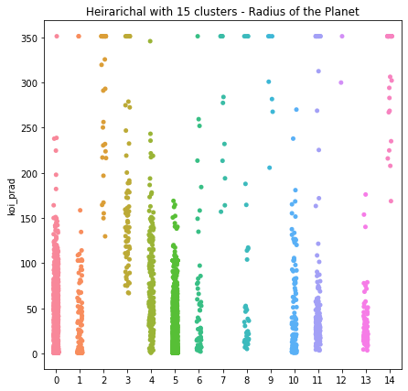
Hierarchal Clustering ‘ward’ method with 15 clusters

Slide 26
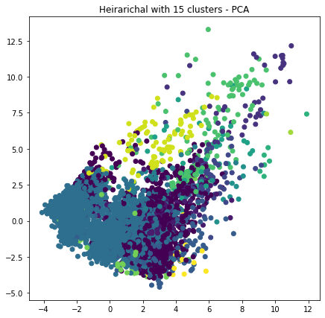
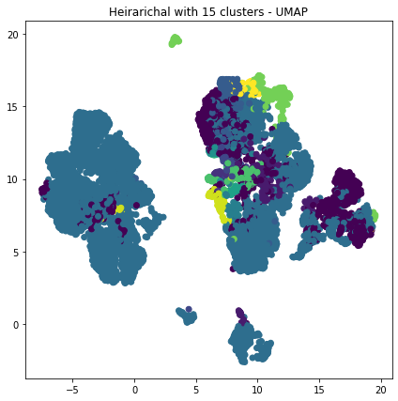
Hierarichal Clustering ‘complete’ method with 15 clusters

Slide 27
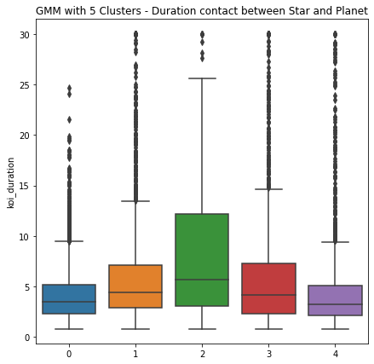
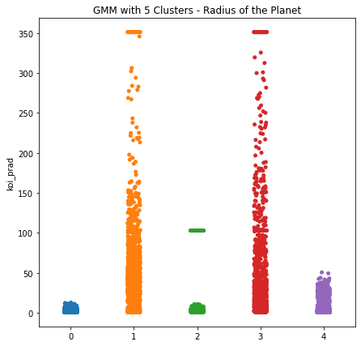
Gaussian Mixture Models with 5 Clusters

Slide 28
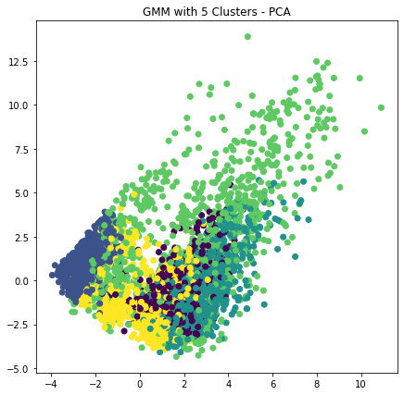
Gaussian Mixture Models with 5 Clusters

Slide 29
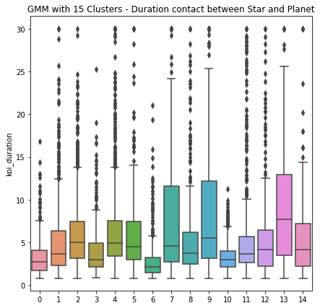
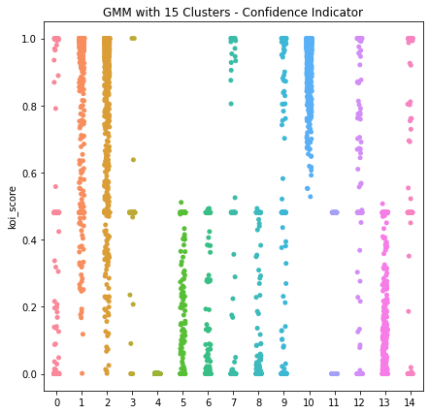
Gaussian Mixture Models with 15 Clusters

Slide 30
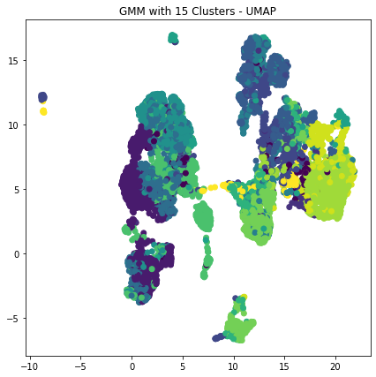
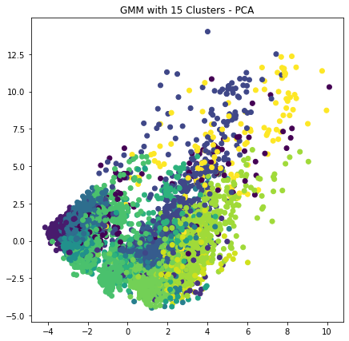
Gaussian Mixture Models with 15 Clusters

Slide 31
Silhouette Scores
 | Silhouette Score 5 Clusters | Silhouette Score 15 Clusters
Kmeans | .21 | .13
Gaussian Mixture Models | .14 | .03
Hierarchal | .19 | .16
 | Silhouette Score
DBSCAN | .21

Slide 32
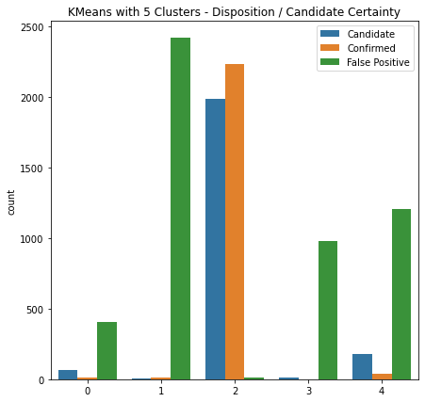
Conclusion – Kmeans with 5 Clusters

Slide 33


Conclusion – Kmeans with 5 Clusters

Slide 34


Conclusion – Kmeans with 5 Clusters

Slide 35


Conclusion – Kmeans with 5 Clusters

Slide 36
Target Audience
Researchers and Scientists / Universities
Students and Enthusiasts
General Public
Public Policy Makers

Slide 37
Future Considerations
Gather the original dataset – possible image?
Understand the feature more / Y-Label
Apply supervised learning methods.
Neural Network / CNN

Slide 38
Questions?

